Slide 1
Academic Paper Database
Group 14:
Joshua Lora, Brianna Buttaccio, Joseph Oh, Jonathan Aurit

Slide 2
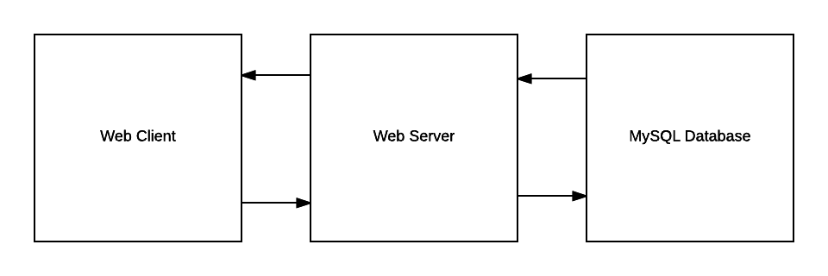
Architecture
Presentation layer: HTML, CSS, JS/jQuery, Bootstrap
Data layer: PHP
Database: MySQL
Notes:
Jon

Slide 3
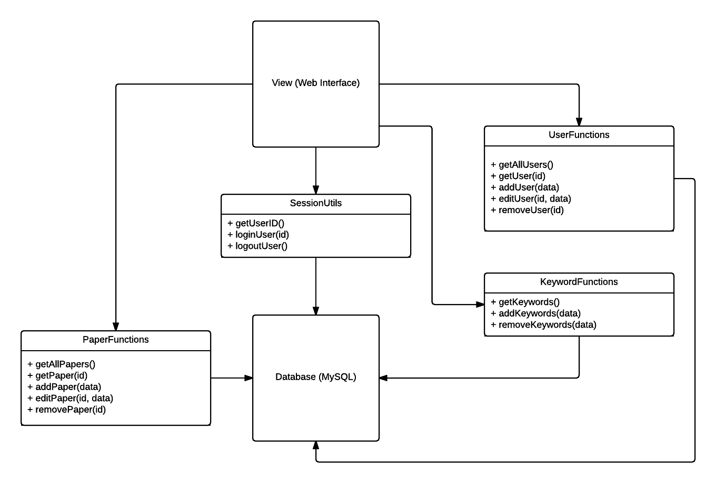
Design Overview
Web-based system due to familiarity and to make it more accessible and easier to distribute
PHP allows easy setup as a web service and provides standard connectivity to MySQL
Use Sessions to control authorization and user credentials
Use jQuery to retrieve data via AJAX in a JSON format
Notes:
Joe

Slide 4
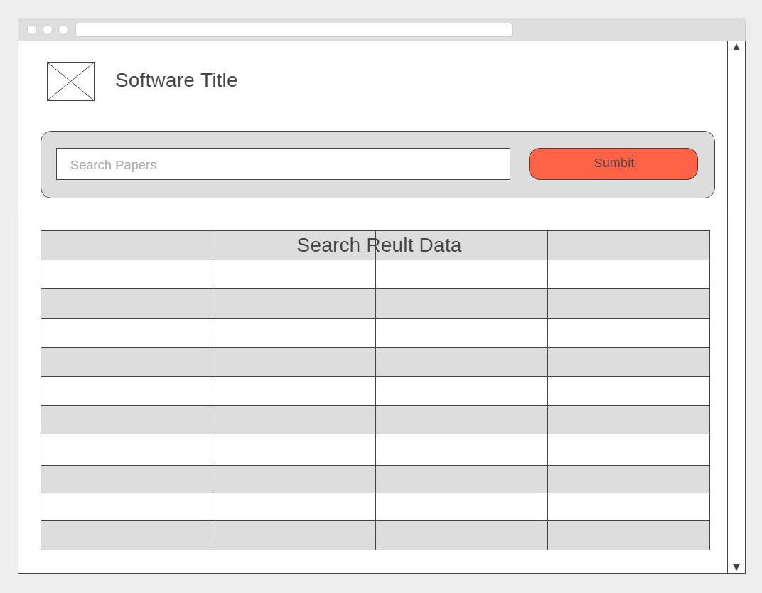
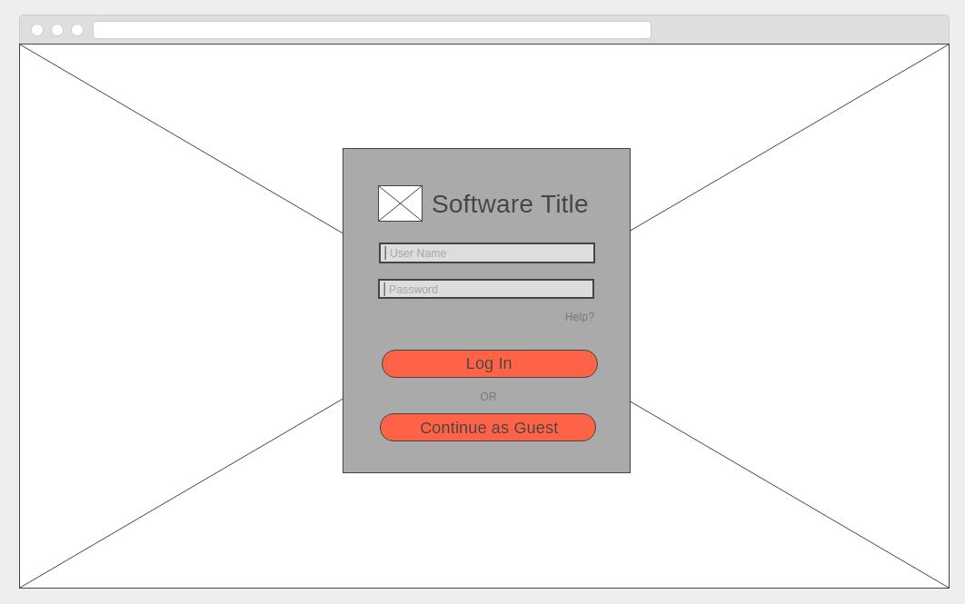
Mockups
Notes:
Brianna

Slide 5
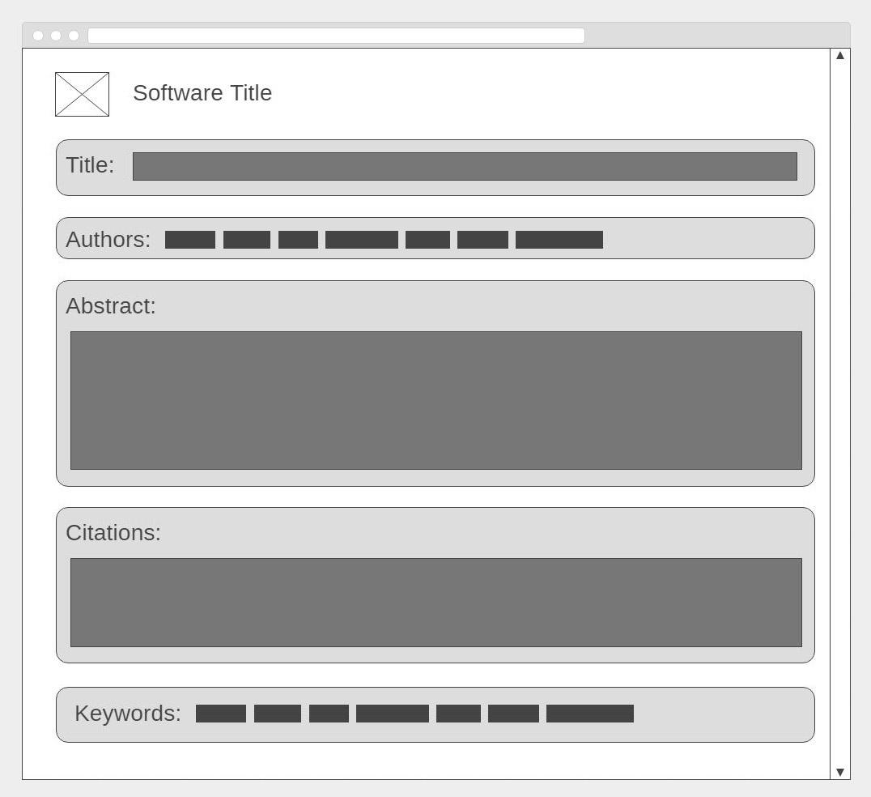
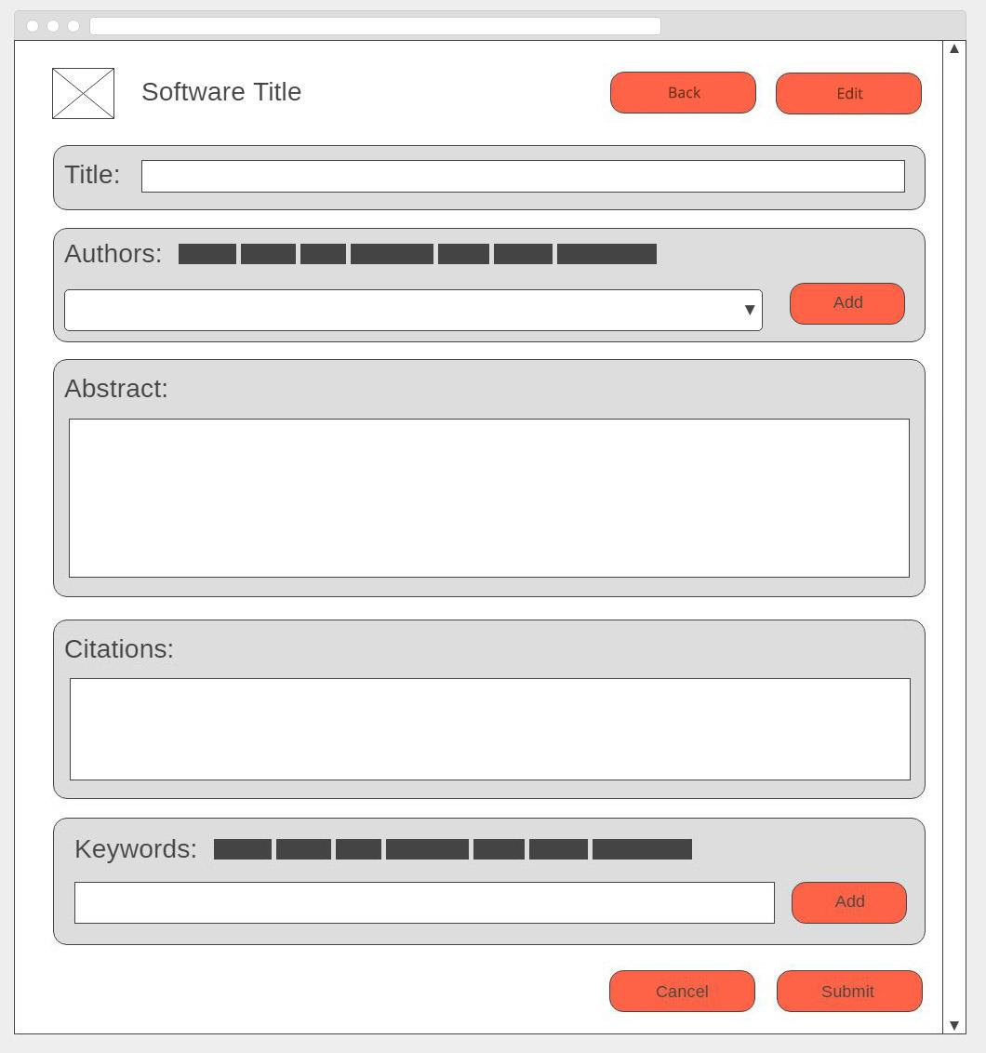
Mockups Cont.
Notes:
Brianna

Slide 6
DEMO

